Slide 1

Farm Management System
Team Members
Thanalaxmi S - 231801179
Suhirtha M P - 231801175
Tanisha S - 231801178

Slide 2
Introduction and Abstract
The Farm Management System is a cutting-edge web application that aims to streamline agricultural activities. By leveraging modern web technologies, it offers a digital platform for effective farm management. The system integrates various functionalities such as farmer kits, contact details, blogs, news, farmers' market, and user accounts.
Developed with HTML for the frontend and powered by MongoDB and PHP for the backend, this system ensures robust data management and a seamless user experience. It provides farmers with tools for resource management, market access, and information dissemination, all in one centralized platform.
Frontend
Backend
Server-side
HTML compiled with Visual Studio Code
MongoDB for data storage
PHP for scripting

Slide 3
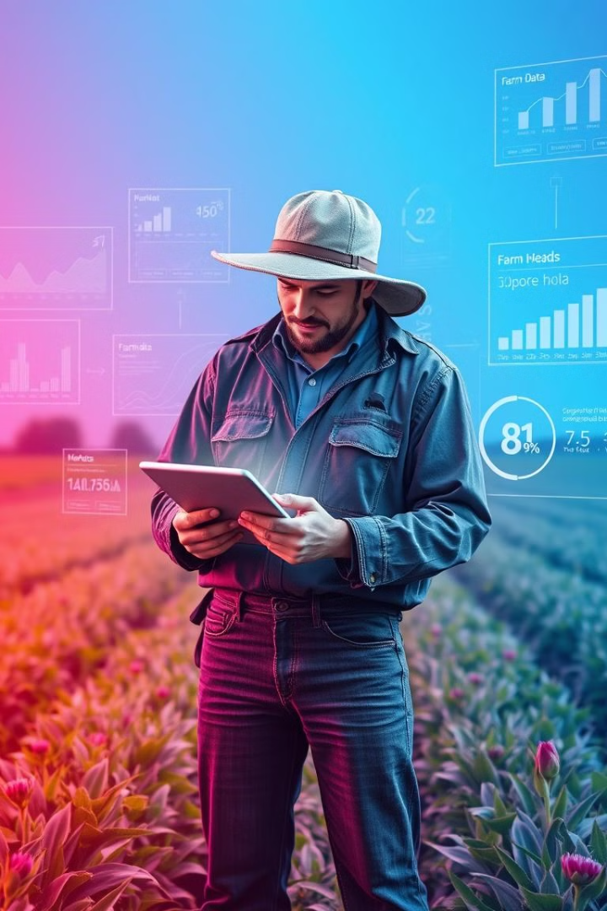
Objectives
1
Streamline Processes
2
Market Access
Offer easy access to market information and resources
Provide a user-friendly web interface to simplify farm management tasks
3
Enhance Communication
4
Centralized Management
Improve information sharing among the farming community
Create a unified platform for managing farm operations, including inventory, sales, and financial records

Slide 4
Existing System vs. Proposed System
The current scenario often relies on traditional methods for farm management, which can be time-consuming and inefficient. Existing systems lack integration and real-time data, leading to suboptimal decision-making. Farmers often use disparate tools for different tasks, such as spreadsheets for record-keeping and separate applications for market information.
Our proposed Farm Management System addresses these limitations by offering an integrated platform with features like a central dashboard, farmer kit, contact details, blogs and news, farmers' market, and personalized user accounts.
Existing System
Proposed System
Traditional methods
Integrated platform
Lack of integration
Real-time data
Time-consuming
User-friendly interface
Prone to errors
Efficient management

Slide 5





Disadvantages of Existing System
Inefficiency
Lack of Integration
Time-consuming and labor-intensive traditional methods
Fragmented systems requiring multiple tools
Data Inaccuracy
High Costs
Error-prone manual record-keeping
Increased operational costs without significant benefits

Slide 6
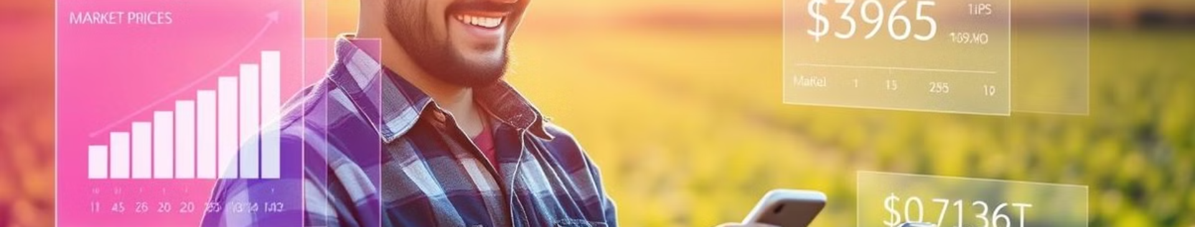
Advantages of Proposed System
Integration
Real-Time Data
Single platform for streamlined farm management processes
Instant access to market information and expert advice
User-Friendly Interface
Scalability
Easy navigation and use for farmers of all tech levels
MongoDB and PHP ensure growth accommodation

Slide 7
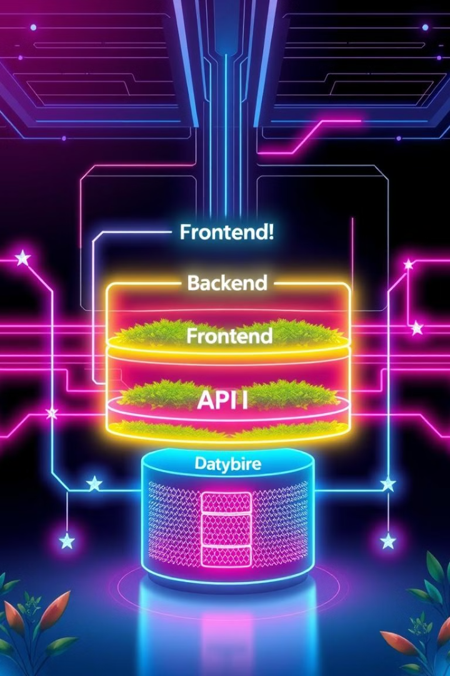
Architecture Diagram
The Farm Management System's architecture is designed for efficiency and scalability. It consists of a frontend developed using HTML, CSS, and JavaScript, providing a responsive and interactive user interface. The backend is powered by PHP for server-side scripting and MongoDB for robust data storage.
An API layer facilitates seamless communication between the frontend and backend, ensuring efficient data exchange. The system is modular, incorporating various components such as Farmer Kit, Contact Details, Blogs, News, Farmers' Market, and User Accounts.

Slide 8
Key Modules
Home Page
1
Central dashboard with activity summaries and weather updates
2
Farmer Kit
Tools for crop yield calculation and pest management
Contact Details
3
Directory of important farming contacts
4
Blogs and News
Latest agricultural articles and expert insights
Farmers' Market
5
Platform for buying and selling farm products
6
My Account
Personalized profiles for managing farm operations

Slide 9




Conclusion and Future Work
The Farm Management System represents a significant leap forward in agricultural technology. By enhancing farm management efficiency and accuracy, it empowers farmers to make data-driven decisions and optimize their operations. The integrated platform addresses the limitations of traditional methods, providing a cost-effective and user-friendly solution.
Looking ahead, future developments may include advanced analytics for predictive farming, a mobile app for on-the-go management, and multi-language support to cater to a global farming community. These enhancements will further solidify the system's role in modernizing agriculture.
Current System
Integrated platform for efficient farm management
Near Future
Advanced analytics and mobile app development
Long-term Vision
Global expansion with multi-language support

Slide 10
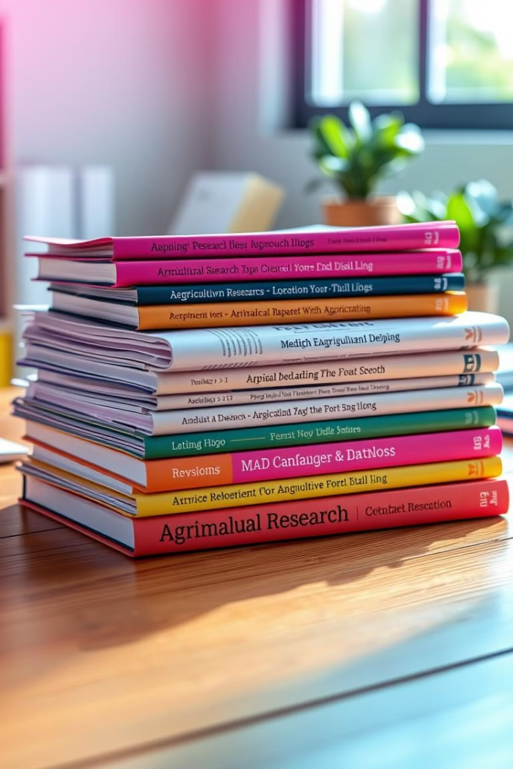
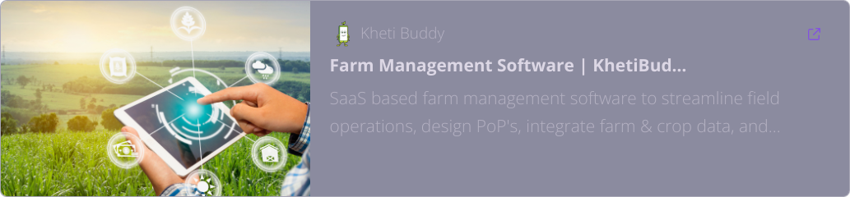

Reference

